Slide 1
Doc2Sent2Vec: A Novel Two-Phase Approach for Learning Document Representation
Ganesh J¹, Manish Gupta^{1,2} and Vasudeva Varma¹
¹IIIT Hyderabad, India
²Microsoft, India

Slide 2
Problem
Learn low-dimensional, dense representations (or embeddings) for documents.
Document embeddings can be used off-the-shelf to solve many IR and DM applications such as,
Document Classification
Document Retrieval
Document Ranking

Slide 3
Power of Neural Networks
Bag-of-words (BOW) or Bag-of-n-grams [Harris et al.]
Data sparsity
High dimensionality
Not capturing word order
Latent Dirichlet Allocation (LDA) [Blei et al.]
Computationally inefficient for larger dataset.
Paragraph2Vec [Le et al.]
Dense representation
Compact representation
Captures word order
Efficient to estimate

Slide 4
Paragraph2Vec
Learn document embedding by predicting the next word in the document using the context of the word and the (‘unknown’) document vector as features.
Resulting vector captures the topic of the document.
Update the document vectors, but not the word vectors [Le et al.]
Update the document vectors, along with the word vectors [Dai et al.]
Improvement in the accuracy for document similarity tasks.

Slide 5
Doc2Sent2Vec Idea - Being granular helps
Should we learn the document embedding from the word context directly?
Can we learn the document embedding from the sentence context?
Explicitly exploit the sentence-level and word-level coherence to learn document and sentence embedding respectively.

Slide 6
Notations
Document Set: D = {d₁, d₂, …, d_{M}}; ‘M’ documents;
Document: d_{m} = {s(m,1), s(m,2), …, s(m,T_{m})}; ‘T_{m}’ sentences;
Sentence: s(m,n) = {w(n,1), w(n,2), …, w(n,T_{n})}; ‘T_{n}’ words;
Word: w(n,t);
Doc2Sent2Vec’s goal is to learn low-dimensional representations of words, sentences and documents as a continuous feature vector of dimensionality D_{w} , D_{s} and D_{d} respectively.

Slide 7
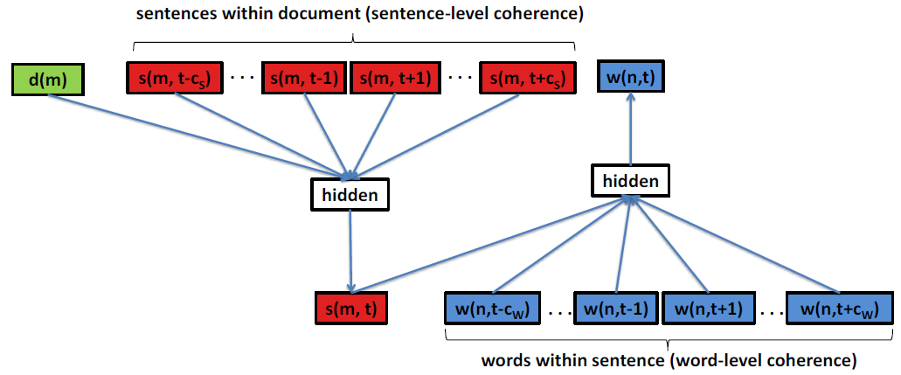
Architecture Diagram

Slide 8
Phase 1: Learn Sentence Embedding
Idea: Learn sentence representation from the word sequence within the sentence.
Input Features:
Context words for target word w(n,t): w(n,t-c_{w}), …, w(n,t-1), w(n,t+1), …, w(n,t+c_{w}) (where ‘c_{w}’ is the word context size)
Target Sentence: s(m,n) (where ‘m’ is the document id)
Output: w(n,t)
Task: Predict the target word using the concatenation of word vectors of context words along with the sentence vector as features.
Maximize the word likelihood:
L_{word} = P(w(n,t)| w(n,t-c_{w}), …, w(n,t-1), w(n,t+1), …, w(n,t+c_{w}), s(m,n))

Slide 9
Phase 2: Learn Document Embedding
Idea: Learn document representation from the sentence sequence within the document.
Input Features:
Context sentences for target sentence s(m,t): s(m,t-c_{s}), …, s(m,t-1), s(m,t+1), …, s(m,t+c_{S}) (where ‘c_{S}’ is the sentence context size)
Target Document: d(m)
Output: s(m,t)
Novel Task: Predict the target sentence using the concatenation of sentence vectors of context sentences along with the document vector as features.
Maximize the sentence likelihood:
L_{sent} = P(s(m,t)| s(m,t-c_{s}), …, s(m,t-1), s(m,t+1), …, s(m,t+c_{S}), d(m))

Slide 10
Training
Overall objective function: L = L_{word} + L_{sent}
Use Stochastic Gradient Descent (SGD) to learn parameters.
Use Hierarchical Softmax (Mikolov et al.) to facilitate faster training.

Slide 11
Evaluation
Dataset
Citation Network Dataset (CND): Sampled 8000 research papers belonging to one of the 8 different computer science fields. [Chakraborty et al.]
Wiki10+ Dataset: 19,740 Wikipedia pages belonging to one or more of the 25 different social tags. [Zubiaga et al.]
Models (Including baselines)
Paragraph2Vec w/o WT [Le et al.]: Paragraph2Vec algorithm without Word Training.
Paragraph2Vec [Dai et al.]
Doc2Sent2Vec w/o WT: Our approach without Word Training.
Doc2Sent2Vec

Slide 12
Scientific Article Classification
Model | F₁
Paragraph2Vec w/o WT | 0.1275
Paragraph2Vec | 0.135
Doc2Sent2Vec w/o WT | 0.1288
Doc2Sent2Vec | 0.1513
Beneficial to learn word vectors too. (~6% and ~18% F₁ increase for Paragraph2Vec and Doc2Sent2Vec)
Doc2Sent2Vec beats the best baseline by ~12%.

Slide 13
Wikipedia Page Classification
Not beneficial to learn word vectors too for Paragraph2Vec shown by ~7% decline in F₁ score. (Problem: Semantically accurate word vectors gets distorted during training)
Doc2Sent2Vec robust to the above problem shown by ~27% increase in F₁ score.
Doc2Sent2Vec beats the best baseline by ~7%.
Model | F₁
Paragraph2Vec w/o WT | 0.0476
Paragraph2Vec | 0.0445
Doc2Sent2Vec w/o WT | 0.0401
Doc2Sent2Vec | 0.0509

Slide 14
Conclusion and Future Works
Proposed Doc2Sent2Vec – a novel approach to learn document embedding in an unsupervised fashion.
Beats the best baseline in two classification tasks.
Future Work:
Extend to a general multi-phase approach where every phase corresponds to a logical sub-division of a document like words, sentences, paragraphs, subsections, sections and documents.
Consider the document sequence in a stream such as news click-through streams [Djuric et al.].

Slide 15
References
Harris, Z.: Distributional structure. Word, 10(23). (1954) 146 – 162
Blei, D., Ng, A.Y., Jordan, M.I.: Latent Dirichlet Allocation. In: JMLR. (2013)
Le, Q., Mikolov, T.: Distributed Representations of Sentences and Documents. In: ICML. (2014) 1188-1196
Dai, A.M., Olah, C., Le, Q.V., Corrado, G.S.: Document embedding with paragraph vectors. In: NIPS Deep Learning Workshop. (2014)
Chakraborty, T., Sikdar, S., Tammana, V., Ganguly, N., Mukherjee, A.: Computer Science Fields as Ground- truth Communities: Their Impact, Rise and Fall. In: ASONAM. (2013) 426-433
Mikolov, T., Chen, K., Corrado, G., Dean, J.: Efficient Estimation of Word Representations in Vector Space. In: ICLR Workshop. (2013) vol. abs/1301.3781
Djuric, N., Wu, H., Radosavljevic, V., Grbovic, M., Bhamidipati, N.: Hierarchical Neural Language Models for Joint Representation of Streaming Documents and their Content. In: WWW. (2015) 248-255

Slide 16
References
Bengio, Y., Ducharme, R., Vincent, P., Jauvin, C.: A Neural Probabilistic Language Model. In: JMLR. (2003) 1137-1155
Collobert, R., Weston, J., Bottou, L., Karlen, M., Kavukcuoglu, K., Kuksa, P.: Natural Language Processing (Almost) from Scratch. In: JMLR. (2011) 2493-2537
Morin, F., Bengio, Y.: Hierarchical Probabilistic Neural Network Language Model. In: AISTATS. (2005) 246-252
Pennington, J., Socher, R., Manning, C.D.: GloVe: Global Vectors for Word Representation. In: EMNLP. (2014) 1532-1543
Rumelhart, D., Hinton, G., Williams, R.: Learning Representations by Back-propagating Errors. In: Nature. (1986) 533-536
Dos Santos, C.N., Gatti, M.: Deep convolutional neural networks for sentiment analysis of short texts. In: COLING. (2014) 69-78
Zubiaga, A.: Enhancing navigation on wikipedia with social tags. In: arxiv. (2012) vol. abs/1202.5469

