Slide 1
Business Development Roundtable
Tim Scott
Manuel Neyra
Diane Nyberg
Kelly Fleskes
Paolo Moroni
Claudia Mucarzel
Jessy Yip
Patti Mariles February 5, 2015

Slide 2
Notes:
This is a Safe Harbor Front slide, one of two Safe Harbor Statement slides included in this template.
One of the Safe Harbor slides must be used if your presentation covers material affected by Oracle’s Revenue Recognition Policy
To learn more about this policy, e-mail: Revrec-americasiebc_us@oracle.com
For internal communication, Safe Harbor Statements are not required. However, there is an applicable disclaimer (Exhibit E) that should be used, found in the Oracle Revenue Recognition Policy for Future Product Communications. Copy and paste this link into a web browser, to find out more information.
http://my.oracle.com/site/fin/gfo/GlobalProcesses/cnt452504.pdf
For all external communications such as press release, roadmaps, PowerPoint presentations, Safe Harbor Statements are required. You can refer to the link mentioned above to find out additional information/disclaimers required depending on your audience.

Slide 3
Program Agenda
1
Welcome and Introductions – Tim Scott
Ecosystem and growth. Partner awards – Tim Scott
Oracle Validated Integration program – Diane Nyberg
Knowledge Zone & communications - Kelly Fleskes
Oracle Business Accelerators – Manuel Neyra
Escalations & registering project milestones – Manuel Neyra
Q&A
2
3
4
5
6
7

Slide 4
Partner Ecosystem & Growth
Partner Awards
Tim Scott

Slide 5
Oracle Validated Integration
Notes:
This slide can also be used as a Q and A slide

Slide 6




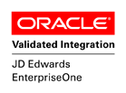



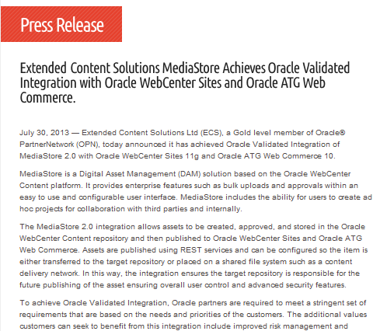


Go-to-Market
OracleJDEdwards
JD Edwards Blog
Attitude@Altitude
@OracleJDEdwards
JD Edwards Professionals

Slide 7
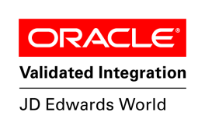
Oracle Validated Integration
Who is it for?
Partners providing solutions that complement and integrate with Oracle Applications.
What is the Value to Partners?
Industry recognized program
Provides valuable resources and opportunities (based on how partner works with Oracle and our customers)
Arms partners with a key competitive differentiator
Establishes credibility with customers
Delivers package of go-to-market benefits
Hundreds of participating partners across numerous Oracle Applications!

Slide 8


Oracle Validated Integration
Partners count on it!
“Oracle Validated Integration establishes credibility with prospective customers and Oracle Sales reps. Our recent OVI achievement has provided our Commodity Trading and Risk Management solution with global exposure!”
Ed Pieters, CEO, Cadran
“Obtaining the Oracle Validated Integration ‘seal of approval’ has been a great boost to ARCTOOLS sales and marketing activities. The program has helped us gain product alignment with JD Edwards and offered valuable ROI.”
Barry Yelverton, CTO, Redfaire & ARCTOOLS
Notes:
Change logo to add E1 and World OVI

Slide 9

Content
Supporting your selling efforts

Slide 10




THE JD EDWARDS KNOWLEDGE ZONE HAS NEW LIFE!
*NEW* PARTNER NEWSLETTERS
*NEW* SUMMIT PRESENTATIONS
*NEW* SALES-TARGETED CONTENT
  Sell Sheets
  Executive and Industry Presentations
  Plus many more documents previously available only on Oracle internal portals
KEY PRODUCT ANNOUNCEMENTS

Slide 11


























Why JD Edwards EnterpriseOne? Achieving a Competive Edge with Low TCO and a Single, Integrated ERP Solution
Elevator Pitch: A mature and robust solution offering deeper capabilities in more areas than any other ERP solution
JD Edwards EnterpriseOne is a proven ERP software suite with extensive core, operational and specific industry functionality for organizations of any size from small, growing companies to global, multi-divisional enterprises. EnterpriseOne is the most modern, collaborative, and configurable user experience available for any ERP solution and is backed by Oracle’s support policies. Adding to this, an eight -year strategic product roadmap shows continued focus on driving business value, while supporting industry best practices, improving the user experience, and increasing productivity. Lastly, JD Edwards supports multiple platforms and provides the lowest total cost of ownership (TCO) of all Tier 1 ERP solutions available today.
Who Do I Sell to? | Why JDE? Provides stability, flexibility, growth and continuous innovation
C-Suite: CEO, CIO, CTO, COO VP/Director: VP Supply Chain, Controller, VP Manufacturing, Director of Customer Service | Low TCO: An independent Nucleus Research study showed that SAP is more than four times more costly than JD Edwards EnterpriseOne. Adaptable to your ‘global’ business requirements: Enables non-technical administrators and end users the flexibility to meet a wide range of business needs using a rich personalization and configuration layer. Grows and expands with your business: Provides an underlying architecture that features a flexible, scalable toolset design built with open standards. JD Edwards offers 70+ applications modules designed for companies to start with a product footprint that meets today's needs, which can easily extend with new products alongside growing business requirements. Adaptable to your IT infrastructure: Certified to run on a broad range of technology platforms from Oracle and other vendors, so JD Edwards fits into your IT strategy today and keeps your options open for the future. Packaged integrations to ‘best-in-class’ applications allows you to quickly add additional capabilities. 8-year published product roadmap: Provides leading strategies for Cloud, Mobile applications, integration, analytics and reporting, and much more! Stronger and better than ever: Where other ERP companies are publishing growth figures in the 2-3% range, JD Edwards continued with double digit growth 3 years in a row – unheard of in the industry! Statistics don’t lie: 82% EnterpriseOne customers are either running or upgrading to the current release; 21% migrating from World Software to EnterpriseOne. Continuous innovation and product leadership makes JD Edwards a leading industry solution. World’s most loyal customer base: Recognized in the industry as the solution with the world’s most loyal customers. Expansive Partner Ecosystem: 25+ years of history with JD Edwards, midsize and up-market, understands the JD Edwards story and keeps up with new products/technologies.
Conversation Starters/Qualifying Questions
Are you currently using an ERP solution? How important is ‘choice’ to you? What are the common constraints you experience? What company strategies are currently planned for this year and does your ERP (or other solution) meet the upcoming needs of those initiatives? For example, (role: controller, CFO) are you pursuing mobile applications such as PO Approval to streamline the procurement process? What are the objectives you want to achieve through technology adoption? Have you adopted, or plan to adopt, a mobile strategy? Do you have access to real time operational information? For example, (role: controller, CFO) does your Accounts Receivable group have access to the top 10 customers and status of their account in real-time? Do your operational areas adhere to ‘management by exception’ strategies? For example, (adapt to role you are speaking to) can you monitor time sensitive backorders, or lagging work orders. Have you looked at your process maturity levels? (adapt to operational area) Do you adhere to best-of-breed maintenance strategies?
Industry Focus: An ERP leader for industry depth
Manufacturing and Distribution: Manufacturing, Automotive, Chemical, Paper & Packaging – Helps manufacturers especially those that operate within a mixed-mode (process, discrete, repetitive, flow/lean etc) manufacturing environment develop, manufacture, and distribute products in a timely fashion. Consumer Goods: Food & Beverage, Fashion and Apparel – Ability to manage complex supply chains, optimize inventory and supplier performance, provide traceability from supplier to store and manage complex pricing scenarios. Projects and Services: Engineering and Construction, Homebuilding – Provide timely information to project stakeholders, manage skilled or certified resources, maximize contract margin by controlling project performance. Asset Intensive: Mining, Natural Resources, Oil and Gas, Green Energy, Chemicals and Lubricants, Commercial and Investment Real Estate, Utilities – industries wherein the core business value proposition relies primarily upon the management of the capital assets.
Solution Highlights | Customers
Innovative user interface; runs on tablets and smart phones (65 mobile apps and counting). Flexible configuration rather than customization. Supported integrations and Oracle Cloud strategies (Oracle Sales Cloud, Oracle Talent Cloud). Real-time operational reporting and analytics solution specifically designed for end users with intuitive interface (One View Reporting). Strategic roadmap includes Cloud solutions, Exa (In-Memory applications), Internet of Things (machine-to-machine), Mobility, Industry. Supports global, multi-division companies. Proven low total cost of ownership (TCO). Multi-platform, choice of deployment, single database, pure internet. Continuous focus on deep industry-wide functionality—’end to end’ from capturing information to providing real-time operational information (out of the box) to the end user.
ASSET INTENSIVE
CONSUMER GOODS
MFG & DISTRIBUTION
PROJECTS & SERVICES
Notes:
This is an example of one of the new sell sheets we created in the last few months.
Intended for sales and partners. High level product positioning for qualification of prospects and customers
15 Available today with more on the way (4 Industry, 1 Upgrade, 10 Product)

Slide 12
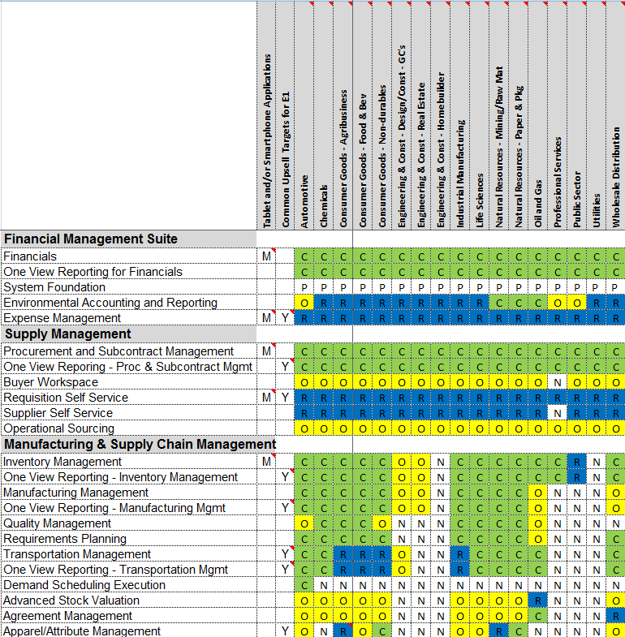
Solution Footprint by Industry
Quick Reference Document with Suggested Core, Recommended and Optional Modules
Target Industries
Mobile Applications
Suggested Upsell Focus Modules
Edge and Cloud Applications
Other Comments

Slide 13
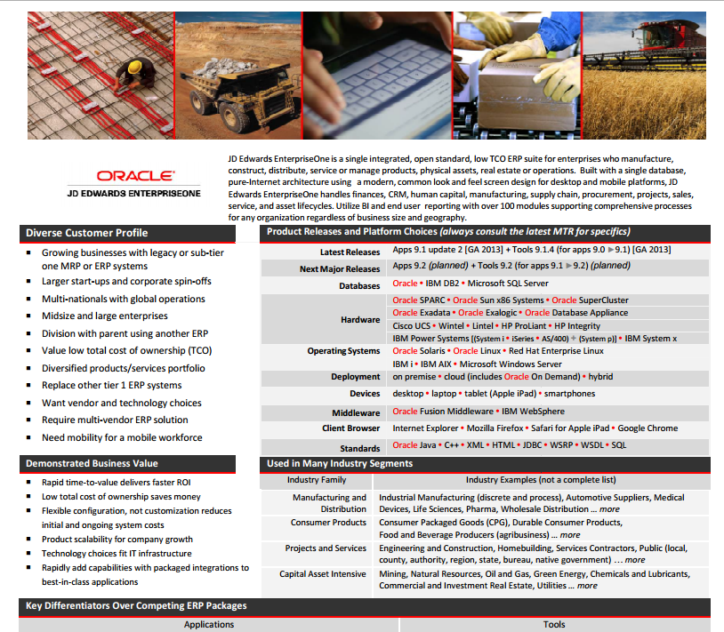
JD Edwards EnterpriseOne Information Flyer
Quick Reference Document
High-Level Product Information
Discusses Business Value, Customer
Profile, Industry Segments, Product
Releases, etc.

Slide 14
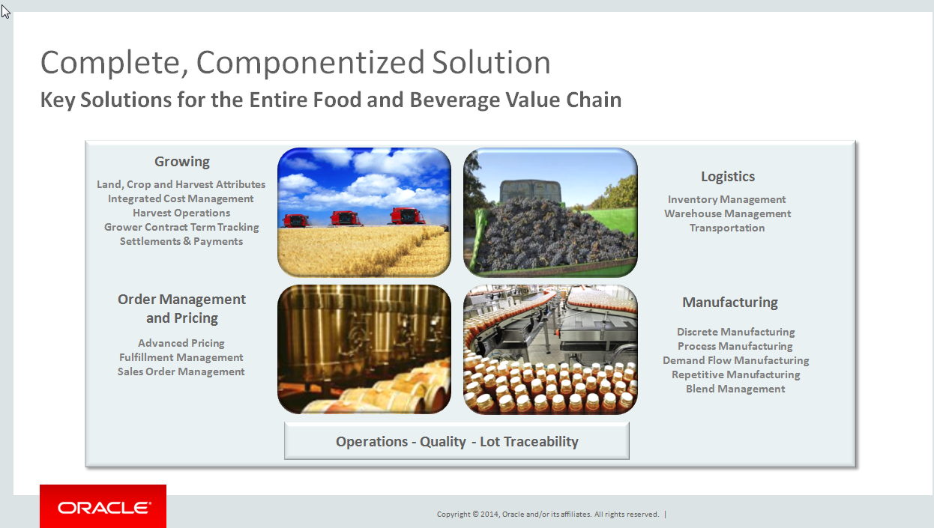
Industry Solution Presentations
Executive and Solution Overviews
Customer-Facing Presentations
Three main industry segments:
  Food and Beverage
  Industrial Manufacturing
  Engineering and Construction

Slide 15
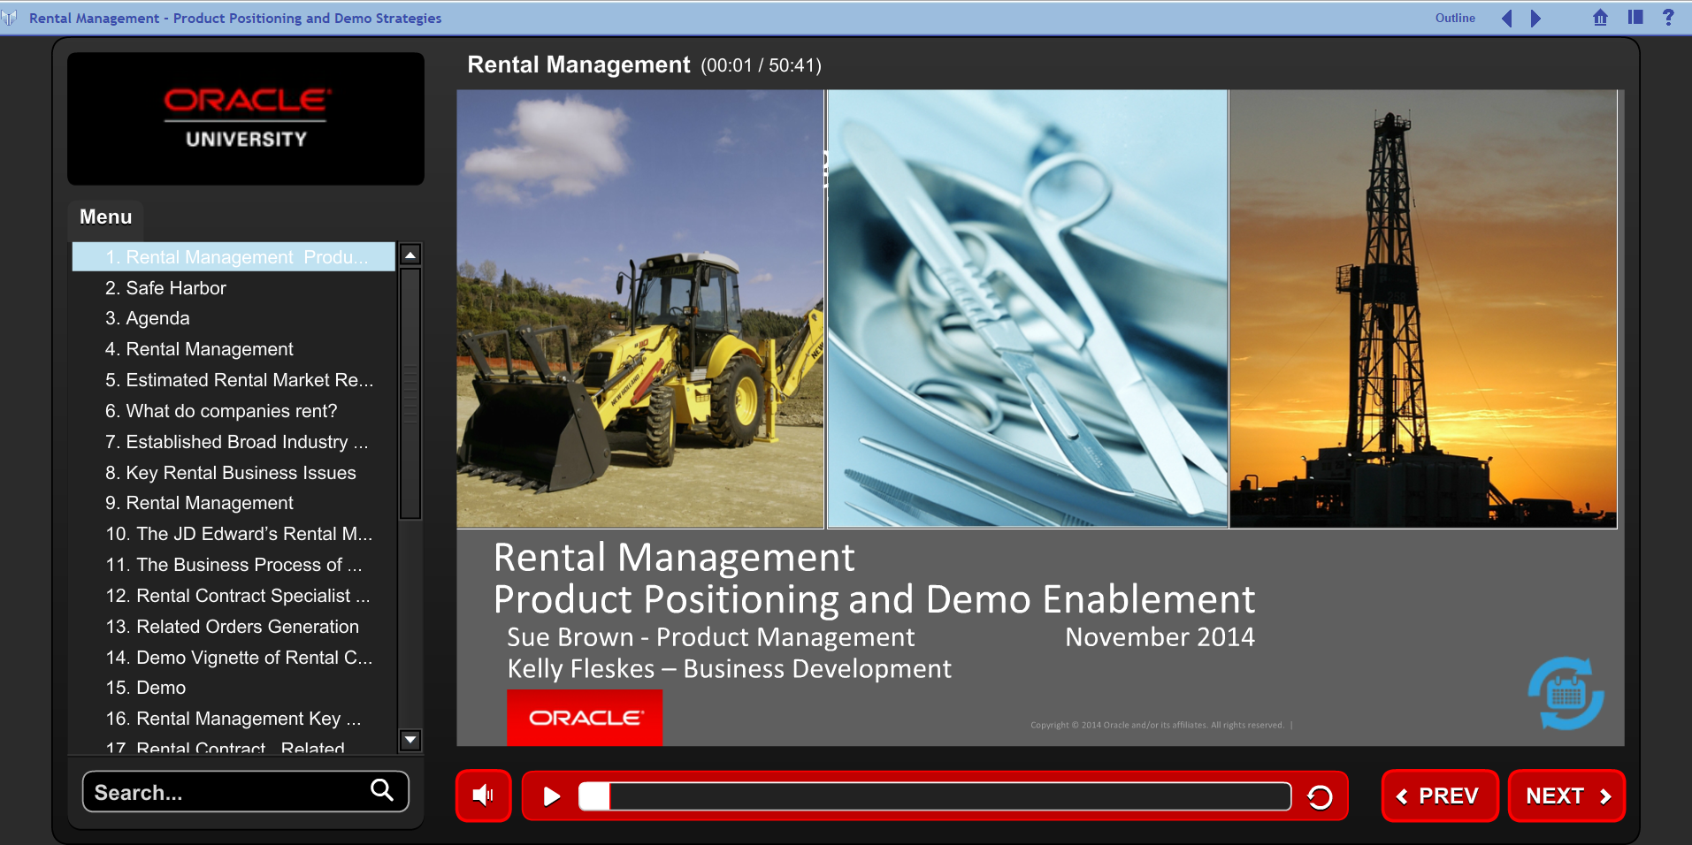
Recorded Content
Focused Effort in 2015 to Record More!
Product Directs
Sales Enablement Presentations
Oracle Direct iSeminars
Partner Recorded Content
YouTube Videos
Tutorials
Summit Sessions (coming soon!)

Slide 16


And There is More!!!
FAQs
Data Sheets
Sales Enablement Presentations
Customer Reference Book and Logos
JD Edwards Reference Booklet
But “Where” to find it?

Slide 17
Escalations and Recording Project Milestones
Manuel Neyra

Slide 18



Help Us to Help You
Enter precise, detailed & complete SRs
Specify appropriate severity
Follow-up on Support requests
Follow standard Support escalation protocol
Contact Business Development Only as Last Resort

Slide 19


Recording JD Edwards Project Milestones
Inform Oracle and Optimize Time to Resolution
Enter a standard Service Request with Oracle Support
  Use the customer’s CSI (Customer Support Identifier)
  Enter the Service request for JD Edwards
  Service Request Description = “Customer <project type> Project Milestones”
    Project Types
      Upgrade
      Migration
      Implementation
      Expansion / additional roll-outs
  Specify the following in the Service Request body:
      “Customer Project milestones for Oracle Support tracking”
      Major and/or critical path project milestones with dates
Update Oracle Support with any project date changes!!!

Slide 20
Oracle Business Accelerators
Manuel Neyra

Slide 21



OBAs for JD Edwards EnterpriseOne
Value Proposition
 | Customers | Partners
 | Fast |  Lower effort and time
 | Predicable |  Reduce your risk
 | Enduring |  Create relationships
 | Leverage leading practices | Implement using leading practices
Notes:
Now lets talk a bit about the value proposition…
Starting with what is in it for customers:
The are fast: the scope is largely defined, the configuration has been pre-tested, resulting in a fast ROI
The are predictable: in terms of the cost, scope and risk
They are enduring: in that they are built on the same E1 product which is highly flexible, with a low TCO.
Customers get a “Tier 1 ERP application at a lower cost”
Moving on to what is in it for partners:
Fast: lower effort and time for initial implementation with the same / better quality
Predictable: Reduced risk so can move to a fixed bid model (know the scope, and improve margin thru reuse)
Enduring: create a positive relationshiop with the initial on time / budget project at a lower cost. Quick time to value can result in follow on projects

Slide 22

Configuration Development Kit (CDK)
Capture & reuse your implementation experience
1
2
3
4
5
Create
Configuration
Package
Configuration
Create
Questionnaire
Wizard
Create
Assets
_{Launch}
_{Business}
_{Accelerator}
Configuration
Utilities
Configuration
Assistant
Business
Accelerate
Authoring Tool
Sample
Assets
Change
Assistant
What?
Tools
Assets
Process
Why?
Create Business Accelerators
Multi-instance Rollouts
Traditional Implementations
System Administration
Who?
Partners
OCS
Customers
Notes:
Build a Business Accelerator
Start with:
Oracle-provided BA
Customer instance
Lab instance
Blank (if you’re crazy)
Use the complementary assets
End User doc, process models, etc

Slide 23

Questions

