Slide 1



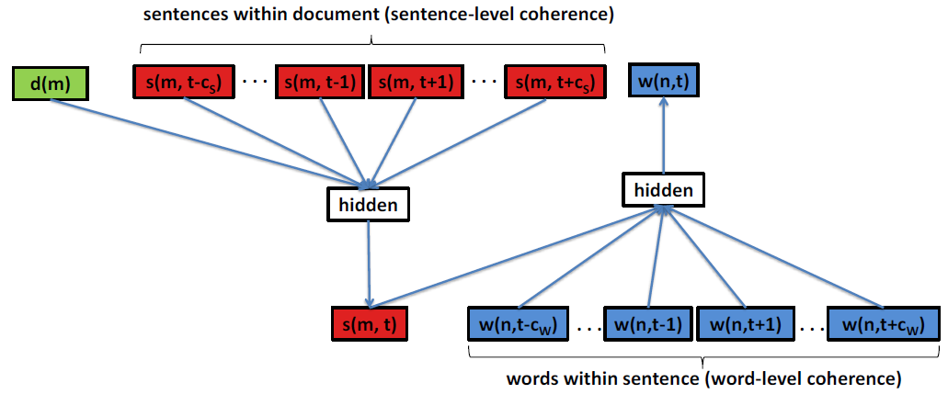
Doc2Sent2Vec: A Novel Two-Phase Approach for Learning Document Representation
Ganesh J¹ Manish Gupta^{1,2} Vasudeva Varma¹
¹IIIT, Hyderabad, India, ²Microsoft, India
ganesh.j@research.iiit.ac.in, gmanish@microsoft.com, vv@iiit.ac.in
Problem:
Learn low-dimensional, dense representations (or embeddings) for documents.
Document embeddings can be used off-the-shelf to solve many IR and DM applications such as
  Document Classification
  Document Retrieval
  Document Ranking
Related Works:
Bag-of-words (BOW) or Bag-of-n-grams
  Data sparsity
  High dimensionality
  Not capturing word order
Latent Dirichlet Allocation (LDA)
  Computationally inefficient for larger dataset.
Paragraph2Vec [1]
  Dense representation
  Compact representation
  Captures word order
  Efficient to estimate
Main Idea:
Should we learn the document embedding from the word context directly?
Can we learn the document embedding from the sentence context?
  Explicitly exploit the sentence-level and word-level coherence to learn document and sentence embedding.
Notations:
Document Set: D = {d₁, d₂, …, d_{M}}; ‘M’ documents;
Document: d_{m} = {s(m,1), s(m,2), …, s(m,T_{m})}; ‘T_{m}’ sentences;
Sentence: s(m,n) = {w(n,1), w(n,2), …, w(n,T_{n})}; ‘T_{n}’ words;
Word: w(n,t);
Doc2Sent2Vec -Architecture Diagram
Phase 1: Learn Sentence Embedding
Idea: Learn sentence representation from the word sequence within the sentence.
Input Features:
Context words for target word w(n,t): w(n,t-c_{w}), …, w(n,t-1), w(n,t+1), …, w(n,t+c_{w}) (where ‘c_{w}’ is the word context size)
Target Sentence: s(m,n) (where ‘m’ is the document id)
Output: w(n,t)
Task: Predict the target word using the concatenation of word vectors of context words along with the sentence vector as features.
Maximize the word likelihood:
L_{word} = P(w(n,t)|w(n,t-c_{w}),…,w(n,t-1),w(n,t+1),…,w(n,t+c_{w}),s(m,n))
Phase 2: Learn Document Embedding
Idea: Learn document representation from the sentence sequence within the document.
Input Features:
Context sentences for target sentence s(m,t): s(m,t-c_{S}), …, s(m,t-1), s(m,t+1), …, s(m,t+c_{S}) (where ‘c_{s}’ is the sentence context size)
Target Document: d(m)
Output: s(m,t)
Task: Predict the target sentence using the concatenation of sentence vectors of context sentences along with the document vector as features.
Maximize the sentence likelihood:
L_{sent} = P(s(m,t)| s(m,t-c_{S}),…,s(m,t-1),s(m,t+1),…,s(m,t+c_{S}),d(m))
Evaluation:
Tasks and Dataset
Scientific article classification: Citation Network Dataset (CND) [3]
Wikipedia page classification: Wiki10+ [4]
Analysis
Beneficial to learn word vectors for CND.
Not beneficial to learn word vectors for Wiki10+ using Paragraph2Vec (Distortion of word vectors problem). Doc2Sent2Vec is robust to this problem.
Doc2Sent2Vec beats the best baseline for both tasks.
Summary:
Doc2Sent2Vec = learning document representation in a multi-phase level leads to high quality document embeddings.
We plan to
  consider other phases such as paragraphs, subsections, sections.
  consider the document sequence in a stream such as news click-through streams.
Model \ Measure (Dataset) | F1 (CND) | F1 (Wiki10+)
Paragraph2Vec w/o WT [1] | 0.1275 | 0.0476
Paragraph2Vec [2] | 0.135 | 0.0445
Doc2Sent2Vec w/o WT | 0.1288 | 0.0401
Doc2Sent2Vec | 0.1513 | 0.0509
Document Classification Performance
References:
Le, Q., Mikolov, T.: Distributed Representations of Sentences and Documents. In: ICML. (2014) 1188-1196
Dai, A.M., Olah, C., Le, Q.V., Corrado, G.S.: Document embedding with paragraph vectors. In: NIPS Deep Learning Workshop. (2014)
Chakraborty, T., Sikdar, S., Tammana, V., Ganguly, N., Mukherjee, A.: Computer Science Fields as Ground- truth Communities: Their Impact, Rise and Fall. In: ASONAM. (2013) 426-433
Zubiaga, A.: Enhancing navigation on wikipedia with social tags. In: arxiv. (2012) vol. abs/1202.5469
Acknowledgements: This work is supported by SIGIR Donald B. Crouch Grant. Thanks to NVIDIA for donating Tesla K40 graphics card.

